Slide 1


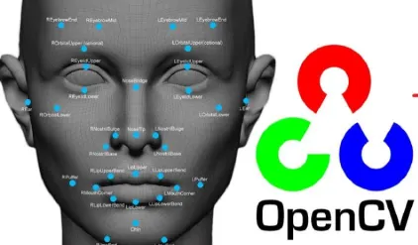
Session 9 :
Introduction to Face Detection

Slide 2

Introduction
Face Detection refers to identifying and locating human faces in digital images.
It forms the basis of many facial recognition and biometric authentication systems.

Slide 3
Learning Outcome
Learn to detect human faces in images using Haar cascade classifiers.
Develop understanding of applying pre-trained models for object detection.

Slide 4
Programming Task Overview
Write a Python script using OpenCV to:
- Load an image.
- Detect faces using a Haar cascade.
- Draw bounding boxes around detected faces.

Slide 5
Why It Matters
Face detection plays a key role in:
- Biometric authentication
- Social media auto-tagging
- Mobile phone facial recognition
- Surveillance systems

Slide 6
Python Code : Real-World Example
1. Unlocking smartphones using facial recognition.
2. Automatic photo tagging on social media platforms like Facebook.

Slide 7
Using Haar Cascades
Haar cascades detect features like eyes, nose, and mouth using patterns in grayscale images.
Use XML files like haarcascade_frontalface_default.xml for face detection.

Slide 8
Implementing Face Detection
Use OpenCV's cv2.CascadeClassifier to load Haar cascade XML.
Call detectMultiScale() to detect multiple faces in an image.

Slide 9
Drawing Bounding Boxes
Use cv2.rectangle(image, (x, y), (x+w, y+h), color, thickness) to highlight detected faces.
Visual feedback enhances understanding and debugging.

Slide 10
Optimizing Detection
Tune parameters like:
- scaleFactor: Determines image scale reduction.
- minNeighbors: Reduces false positives by requiring multiple detections.

Slide 11
Preprocessing for Face Detection
Convert input images to grayscale.
Apply histogram equalization or contrast adjustments to make facial features more distinguishable.

Slide 12
Python Code:
Face Detection
Title: Multi-Face Detection with Scale and Neighbor Tuning
Objective:
- Detect multiple faces in a single image
- Adjustable parameters for fine-tuning detection precision

Slide 13
Step 1 – Classifier & Image Preparation
Classifier Loading:
- Load Haar cascade classifier with cv2.CascadeClassifier
- Use frontal face XML file and ensure successful loading
Image Processing:
- Load image and convert to grayscale using cv2.cvtColor
- Grayscale improves compatibility with classifier

Slide 14
Step 2 – Interactive Parameter Tuning
Trackbar Controls:
- Create trackbars using OpenCV
- Scale Factor (1.05–1.5): Controls image shrinkage
- Min Neighbors (1–10): Validates face detections
- Helps reduce false positives

Slide 15
Step 3 – Face Detection & Visualization
Face Detection:
- Use detectMultiScale() with trackbar values
- Apply minimum size filter (e.g., 30x30)
Visualization:
- Draw blue rectangles around faces with cv2.rectangle
- Add count labels with cv2.putText

Slide 16
Step 4 – Real-Time Display & Robustness
Dynamic Updates:
- Real-time display loop updates with trackbar changes
- Press 'q' to exit the loop
Robustness:
- Handles scenarios with no face detections
- Avoids empty loops or crashes gracefully

Slide 17

Python Script on Face Detection
PART 1
import cv2
def nothing(x):
pass
# Load the Haar Cascade classifier
face_cascade = cv2.CascadeClassifier(cv2.data.haarcascades + 'haarcascade_frontalface_default.xml')
if face_cascade.empty():
raise IOError("Failed to load face cascade classifier!")

Slide 18
Python Script on Face Detection
PART 2
# Load and preprocess the image
image = cv2.imread('group_photo.jpg')
if image is None:
raise ValueError("Image not found!")
gray = cv2.cvtColor(image, cv2.COLOR_BGR2GRAY)
# Create a named window and trackbars
cv2.namedWindow('Face Detection')
cv2.createTrackbar('Scale x100', 'Face Detection', 105, 150, nothing) # Scale from 1.05 to 1.5
cv2.createTrackbar('Min Neighbors', 'Face Detection', 5, 10, nothing)

Slide 19
Python Script on Face Detection
PART 3
while True:
# Get trackbar values
scale_val = cv2.getTrackbarPos('Scale x100', 'Face Detection') / 100.0
min_neighbors = cv2.getTrackbarPos('Min Neighbors', 'Face Detection')
# Detect faces
faces = face_cascade.detectMultiScale()
gray,
scaleFactor=scale_val,
minNeighbors=min_neighbors,
minSize=(30, 30)
)

Slide 20
Python Script on Face Detection
PART 4
# Copy image for drawing
output = image.copy()
face_count = 0

Slide 21
Python Script on Face Detection
PART 5
for (x, y, w, h) in faces:
face_count += 1
cv2.rectangle(output, (x, y), (x+w, y+h), (255, 0, 0), 2)
cv2.putText(output, f"Face #{face_count}", (x, y-10), cv2.FONT_HERSHEY_SIMPLEX, 0.6, (255, 0, 0), 2)
if face_count == 0:
cv2.putText(output, "No faces detected", (20, 30), cv2.FONT_HERSHEY_SIMPLEX, 0.8, (0, 0, 255), 2)

Slide 22
Python Script on Face Detection
PART 6
# Show result
cv2.imshow('Face Detection', output)
# Exit on 'q'
if cv2.waitKey(1) & 0xFF == ord('q'):
break
cv2.destroyAllWindows()

Slide 23
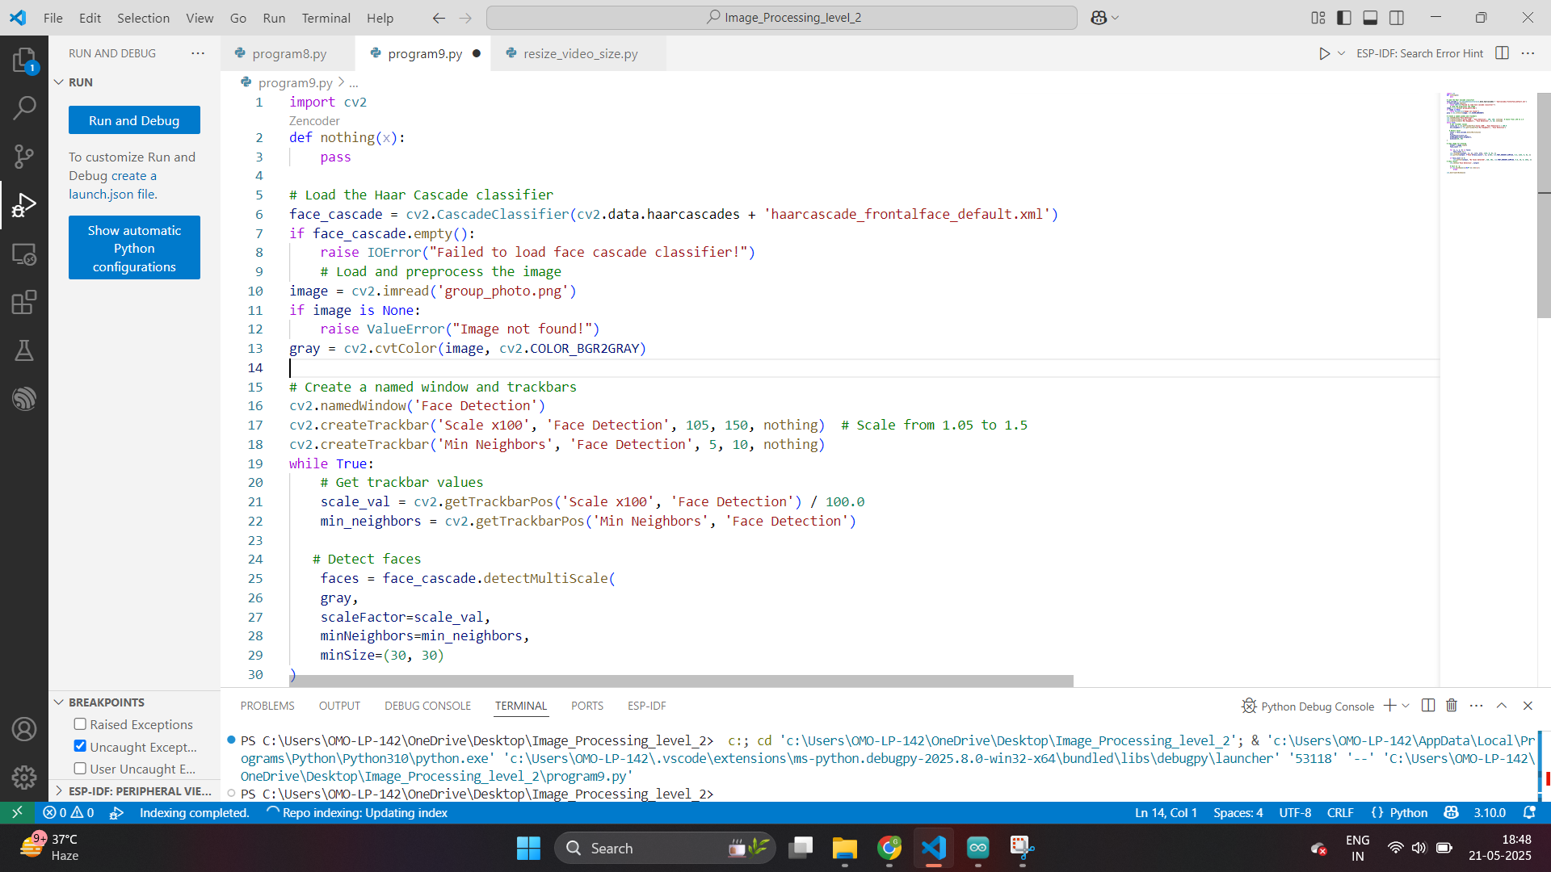

Slide 24
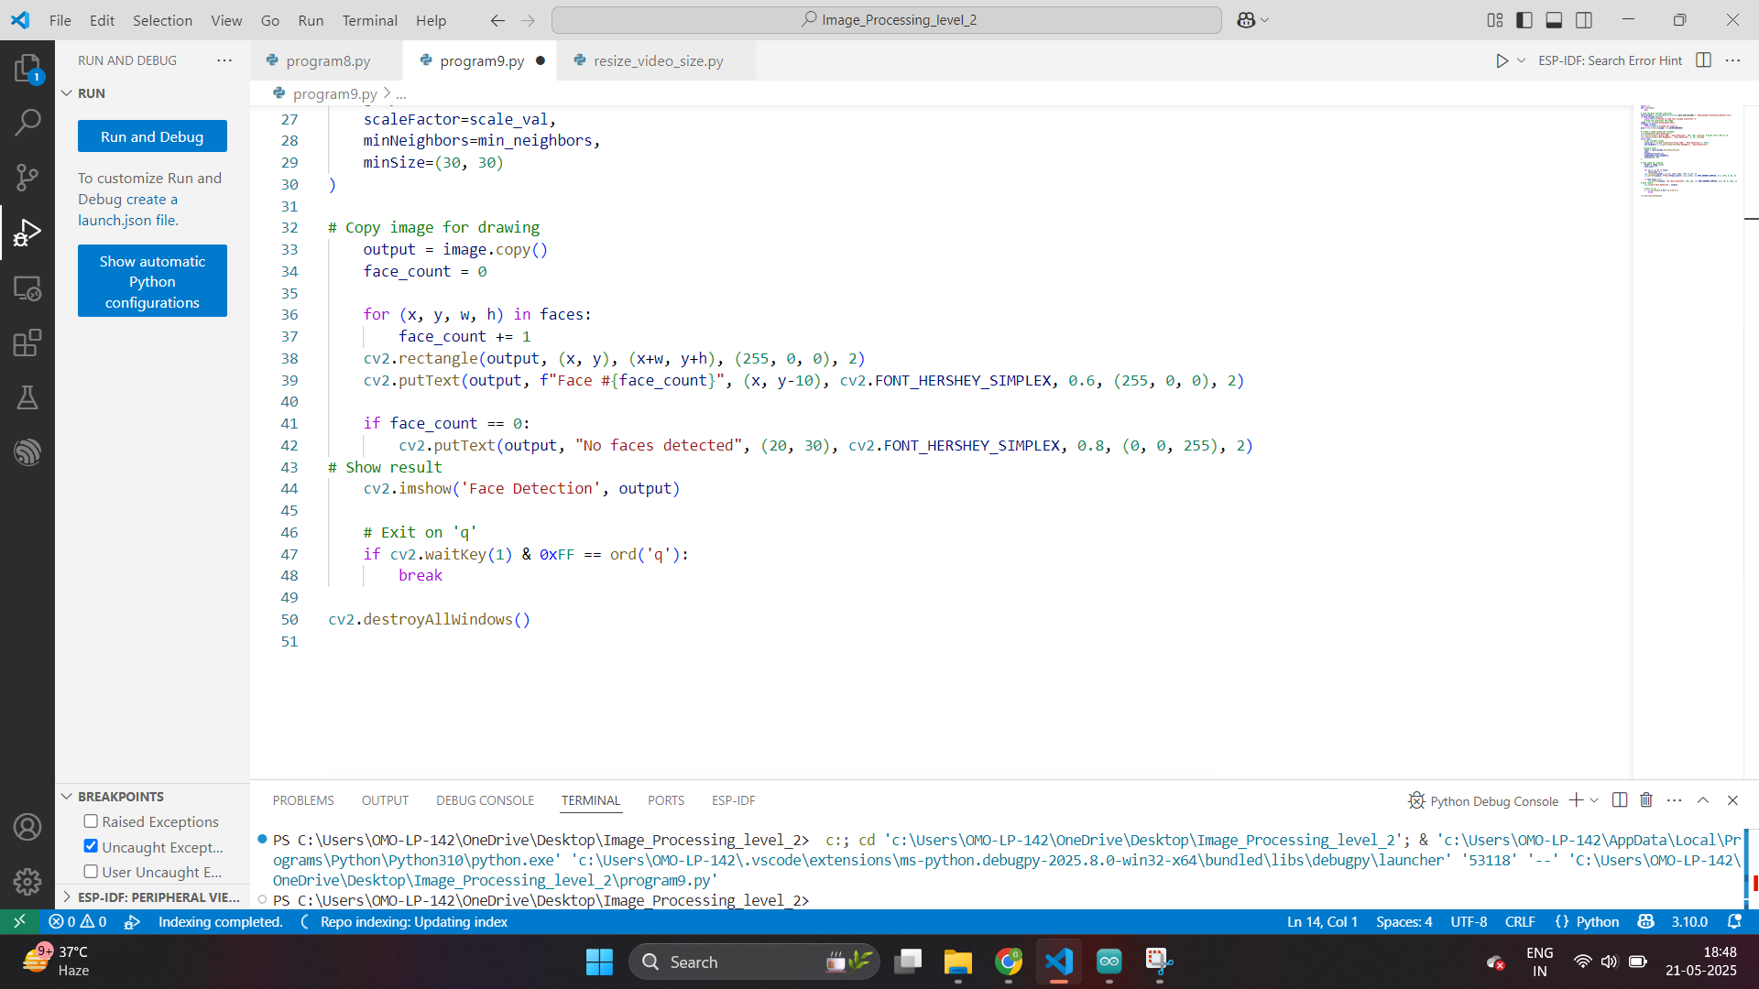

Slide 25
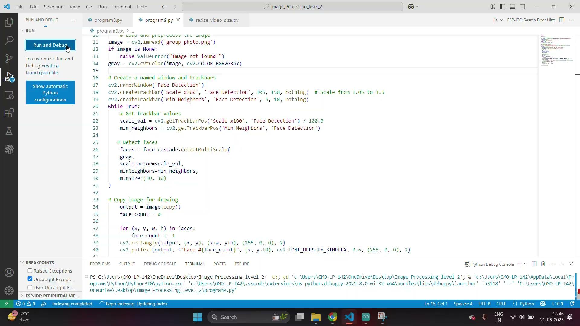

Slide 26
Exercise
1. What is the primary objective of face detection?
A. Enhance image quality B. Identify and locate human faces in digital images C. Measure facial expression intensity D. Replace image backgrounds
Answer: B
2. Which OpenCV class is used to load Haar cascade classifiers?
A. cv2.HaarLoader B. cv2.FaceRecognizer C. cv2.CascadeClassifier D. cv2.FaceCascade
Answer: C

Slide 27
Exercise
3. What file format is commonly used for Haar cascade classifiers?
A. .json B. .xml C. .yaml D. .txt
Answer: B
4. What function is used to detect faces using a Haar cascade?
A. detectFaces() B. findFaces() C. detectMultiScale() D. locateObjects()
Answer: C

Slide 28
Exercise
5. Why is it recommended to convert the image to grayscale before detection?
A. Reduces processing time B. Increases image contrast C. Improves compatibility with Haar features D. Makes the image look better
Answer: C
6. What is the purpose of the scaleFactor parameter in face detection?
A. Controls image brightness B. Sets face detection area C. Determines how much the image size is reduced at each scale D. Adjusts the face size manually
Answer: C

Slide 29
Exercise
7. Which parameter helps in reducing false positives during face detection?
A. faceSize B. brightnessFactor C. minNeighbors D. colorThreshold
Answer: C
8. What function is used to draw rectangles around detected faces?
A. cv2.drawBox() B. cv2.rectangle() C. cv2.drawFace() D. cv2.boxFace()
Answer: B

Slide 30
Exercise
9. How can detection parameters be adjusted in real-time in the project?
A. Through console input B. Using sliders in a GUI C. Using trackbars in OpenCV window D. Through XML file editing
Answer: C
10. What happens if no face is detected in the image?
A. The program crashes B. A warning pops up C. It gracefully handles the scenario D. The screen goes blank
Answer: C

